Slide 1
Where to Open a New Restaurant in Toronto
IBM Applied Data Science Capstone
Xinyao Jie

Slide 2
Business Problem
Location of a restaurant is one of the most important decisions that will determine whether the restaurant will be a success or a failure
The objective of this capstone project is to analyze and select the best locations in the city of Toronto, Canada to open a new restaurant
This project is particularly useful to someone who want to start their own restaurant and investors looking to open or invest in new restaurants in the city of Toronto

Slide 3
Data Sources
List of neighborhoods in Toronto which defines the scope of this project which is confined to the city of Toronto. Raw data can be explored in Wikipedia https://en.wikipedia.org/wiki/List_of_postal_codes_of_Canada:_M
Latitude and longitude coordinates of those neighborhoods. This is required in order to plot the map and also to get the venue data. They can be accessed using Python Geocoder package
Venue data, particularly data related to different restaurants. We will use this data to perform clustering on the neighborhoods. we will use Foursquare API to get the venue data for those neighborhoods

Slide 4
Methodology
Web scraping Wikipedia page for neighborhoods list and clean data
Get latitude and longitude coordinates using Geocoder
Use Foursquare API to get venue data
Group data by neighborhood and calculating frequency of each venue category
Filter venue category by Restaurant related categories
Perform clustering on the data by using k-means clustering
Visualize the clusters in a map using Folium

Slide 5
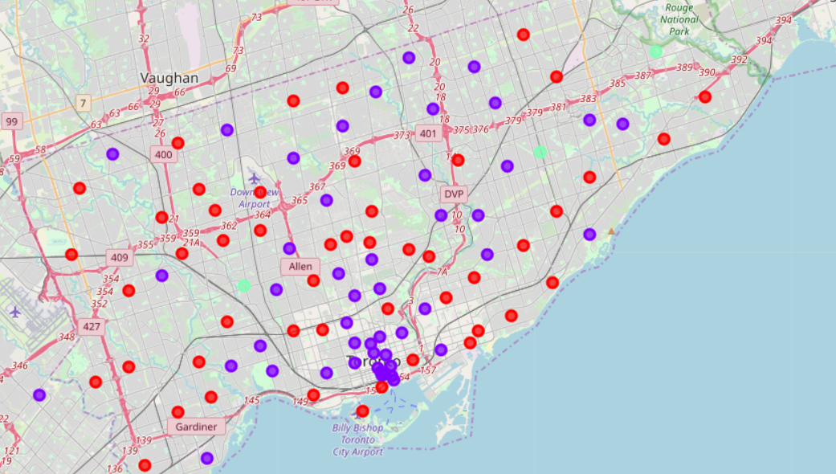
Results
Cluster 0: Neighbourhoods with low frequency of restaurants. Marked as red dots
Cluster 1: Neighbourhoods with mid frequency of restaurants. Marked as purple dots
Cluster 2: Neighbourhoods with high frequency of restaurants. Marked as green dots

Slide 6
Discussion
This frequency is an absolute value but relative to the venue density which is related to population density
Neighborhoods in cluster 0 are perfect place to start a new restaurant because literally you will face no change here.
Neighborhoods in cluster 1 will face some competition but it’s still profitable. Restaurants owners with unique menus or high quality of cuisine will stand out from the competition and can potentially make a large amount of money because of high population density
Neighborhoods in cluster 2 are likely suffering from intense competition. We definitely don’t want to open our restaurant in that place where there are not many customers but enough restaurants

Slide 7
Conclusion
Neighborhoods in cluster 0 are the most preferred locations to open a new restaurant. There are little competition and you will make money.
Neighborhoods in cluster 1 are okay to open a new restaurant. Also, in central city area, owners with unique competition advantages can make a lot of money.
Neighborhoods in cluster 2 are definitely not good places to open a new restaurant.

Slide 8
THANK YOU!

